Slide 1

COMP-SCI 5560 (SS16) - Knowledge Discovery and Management
Wisdom Restaurant Recommendation System
(Class Project - Recommendation System)
Team 5 - Wisdom
Samaa Gazzaz (9) | Pooja Shekhar (38) | Chen Wang (44) | Dayu Wang (45)
 |  |  | (Presenter)
July 25th, 2016

Slide 2






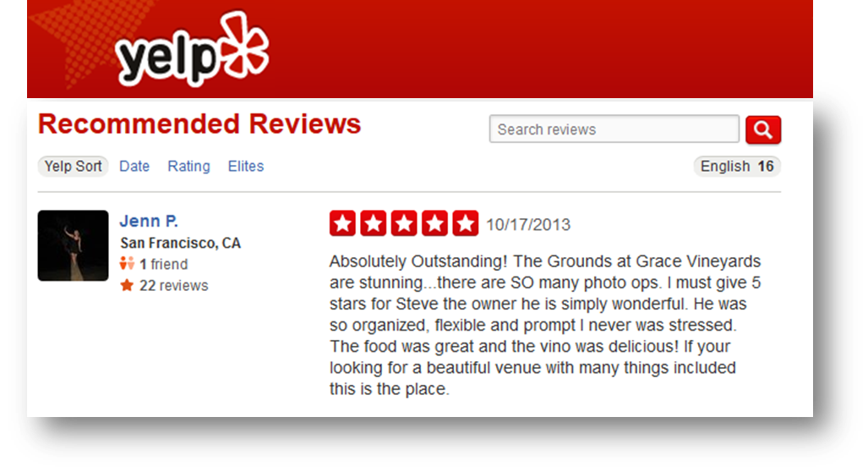



·Motivation - Why Restaurant Recommendation?
“What to eat tonight?”
- The most “difficult” question
- The question had been asked for the most times
Directly related to eating
Restaurant
Many free APIs available
Natural language processing

Slide 3
·Wisdom Recommendation - Architecture
Data Training Model
Ontology Processor
Feature Vector Generator
Relation Analyzer
TF-IDF Top Words Remover
LDA Processor
NLP Processor
Data Training Model
Correlation Learning Model
UI
Layer 3
Correlation Learning Model
User Input Handler
Layer 2
Algorithm
Web Handler
Layer 1

Slide 4

·Pentagonal Analysis - “Novel” Idea of Comparison
Food
3.8
Popularity
4.1
3.1
Ambiance
2.7
4
Cost Performance
Service
Data Processing
1. Find synonyms for corners. 2. Generate feature vectors. 3. Find relations. 4. Ontology learning
Comparison
1. Satisfaction degree 2. General rating (average) 3. Standard deviation 4. Food quality

Slide 5
·Demo - Web Application
-> Programming Language: Scala / Java
-> Library Dependencies: SBT for Scala /Java &. Maven for Web
-> Platform: IntellIJ IDEA Ultimate 2016.2
-> Web Server Configuration: Tomcat 8.5.4
-> Whole Data Size: 196,673 Restaurants
-> Demo Data Size: 1,910 Restaurants
-> Expected Running Time: Less Than 10 Seconds
-> UI: Web Pages

